Slide 1
Surviving the Titanic
W200 Section 2
Project 2: Data Analysis
Authors:
Danish Iqbal, Matthew Holmes, Kalvin Kao

Slide 2
Background

Slide 3
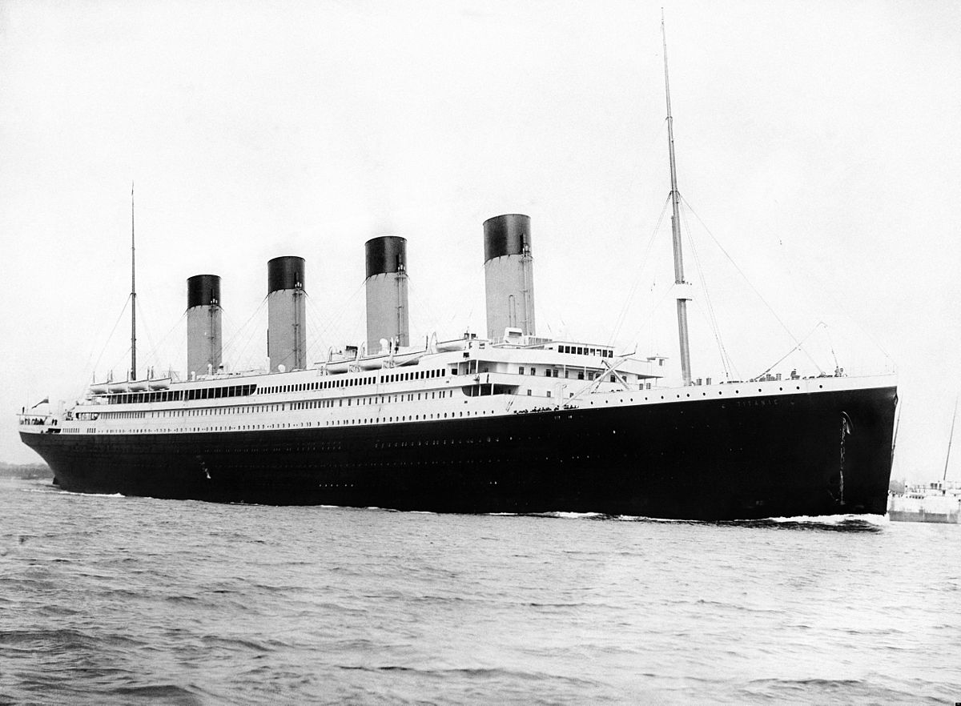
The Titanic
Built in 1912 in Belfast, Ireland
Largest vessel afloat!
Transatlantic passenger and mail service
Southampton <--> New York
Started maiden voyage on April 10, 1912
2208 passengers and crew
Collided with an iceberg four days later
1496 people died
712 survived
Notes:
Total capacity was 3300 (2435 passengers, 900 crew)

Slide 4
The Data

Slide 5
Features of Survival Status
1309 passengers (out of 1317)
Crew excluded
14 variables
passenger class, gender, age, name, ticket ID, cabin, point of embarkment, lifeboat, body ID, home/destination, familial relations, fare, survival
Vanderbilt University - Department of Biostatistics
https://www.encyclopedia-titanica.org/

Slide 6
Questions

Slide 7
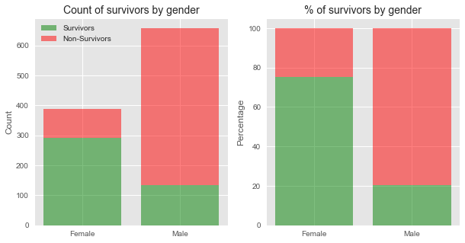

How did survival rates differ between men and women?
No Missing Values.
Womens survival rate is much higher than men's in terms of count and %.
WCF was followed on the Titanic, sorry Leo fans!
Was WCF standard practice???
Notes:
The first feature that we looked at was gender
This was a clean feature that did not have any missing values
The 2 plots show the count and percent of survivors by gender
Almost 6x more males than females died or 53% delta
The Titanic movie got it right Sorry Leo Fans!!!

Slide 8
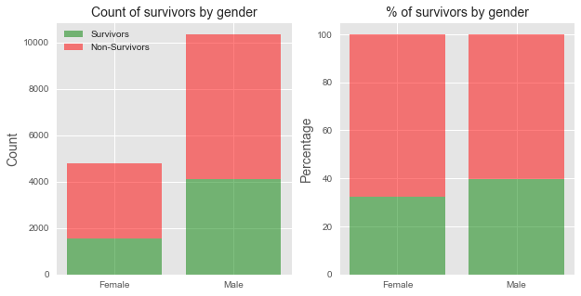
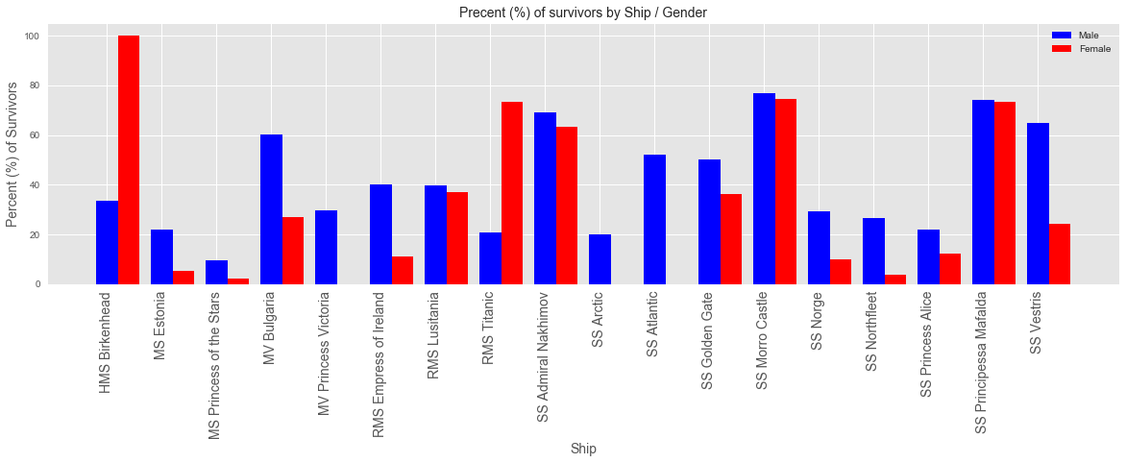
How do gender survival rates on the Titanic compare with other shipwrecks?
18 maritime disasters spanning 3 centuries, 15,000 passengers, and 30 nationalities.
With the exception of the Birkenhead and Titanic, the men usually have a higher survival rate than women.
Notes:
I used python to read and merge and format data from 18 different ships spanning 3 centuries, 15,000 passengers, and 30 nationalities
By count 2.5x more men survive shipwrecks though many more men are on the ships
By percentage about %5 more men survive
Drilling down further by ship Titanic and Birkenhead are the exceptions
May have to do with time and duration of evacuation or instructions to the crew for evacuating procedures

Slide 9
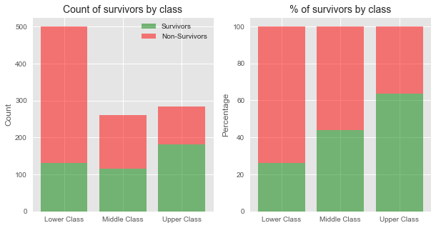
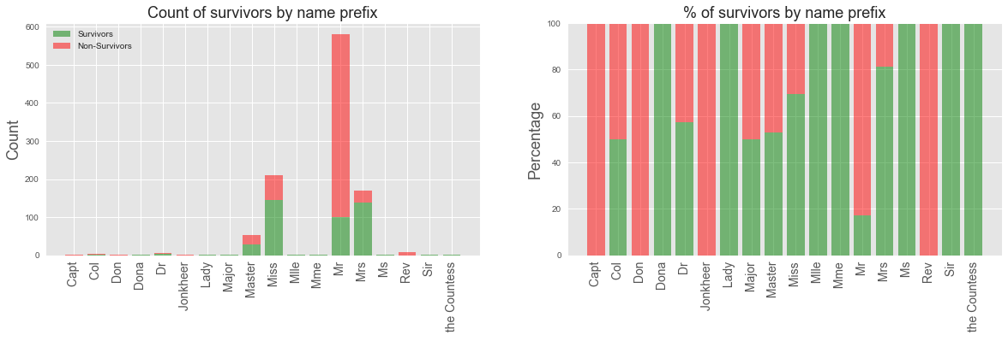
How does social status affect survival rate (pclass and name)?
Lower class passengers had the worst survival rate
Upper class passengers had the highest survival rate.
The Mr.’s had the worst survival rates while the Miss’s and Mrs.’s, Masters, and the Countess had high survival rates.
Notes:
Passenger class was a clean feature no missing data
Lower class passengers had the lowest survival by count followed by middle and upper class
By percentage ranking is from lower to upper with a 20% delta between classes
Name prefixes confirm Mrs. and Miss. had higher survival than Mr.
Also Countess, Master, Mlle, Mme, and Dona survived, maybe they had preferential treatment the one off prefixes seem to have survived well

Slide 10
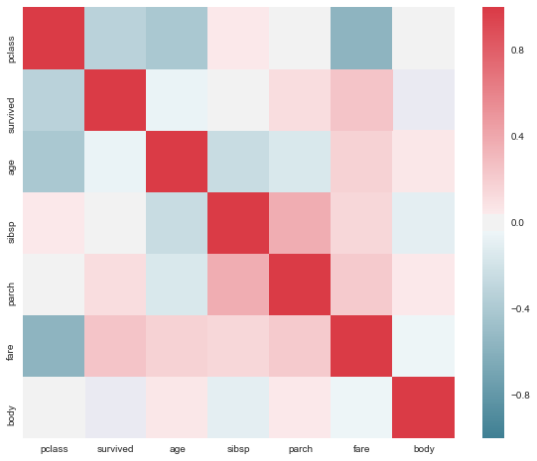
How did survival rates differ between children, adults and elderly?
Correlation Heat Map
Age has 263 missing values removed, no strong correlations.
Tried mean and median, imputation filling in by class.
Linear regression was also problematic creating negative ages.
Project for future work . . .
Notes:
Age was missing a significant amount of data
Age didn’t have any strong correlations to any other features looking at the correlation heat map pclass was the highest at around -0.4
Since there weren’t any strong correlations we excluded the missing data
However, we did try to fill them in with median/mean and using linear regression but this caused data integrity issues.

Slide 11
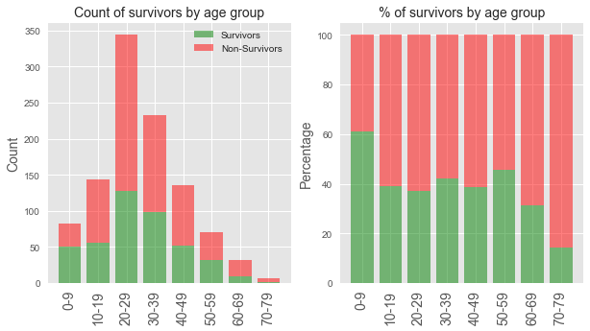
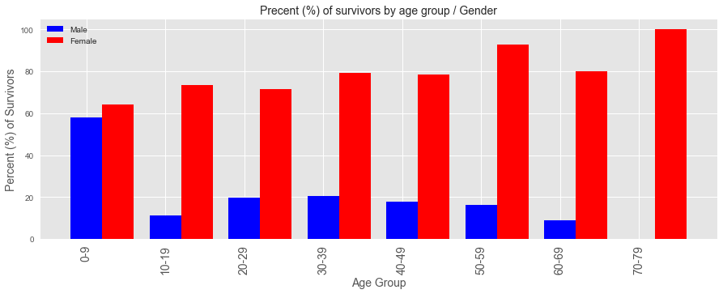
How did survival rates differ between elderly, adults and children?
Male Female children had the highest survival rates.
Adults suffered the largest losses by count though their percentage was uniform.
Elderly > 60yrs had a diminishing survival rate.
Notes:
By count the age groups from 20-39 had the lowest survival
By percentage though group from 10-59 had uniform survival
0-9 group had the highest survival percentage this could conceivably be classified as the children group
>60 group has diminish survival percentage possibly driven by lower counts
Drilling down further children both male and female have a high survival
At all other age groups females have a much higher survival rate then men

Slide 12
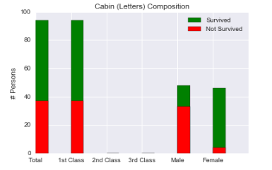
What were cabins like?
Creation of new variables, cabin letter, which groups cabins by their first letter (A, B, C, D, E, F, G, T). This roughly correlates to floor level
1015 missg values, of which 693 come from 3rd class passengers
Interactive plot to show composition of cabin_letter by class and sex

Slide 13
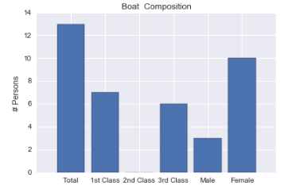
Who was in the lifeboats?
824 missing values
Almost everyone who was in a boat survived.
Only 9 people recorded in boats died.
23 people don't have a boat record but survived. Possible no-shows?
Avg person per boat

Slide 14
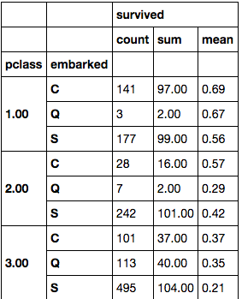
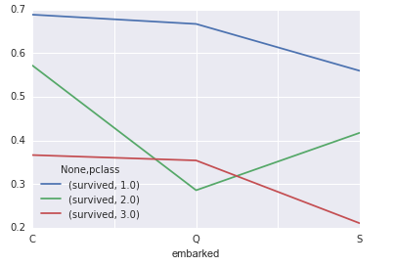
Did points of embarkment affect survivorship?
Passengers embarking from Cherbourgh had the highest survival rates across all classes.

Slide 15
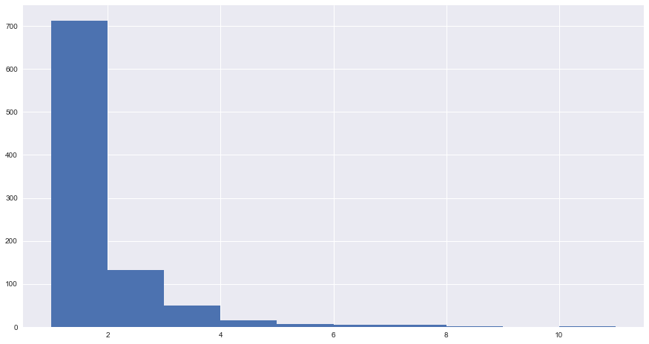
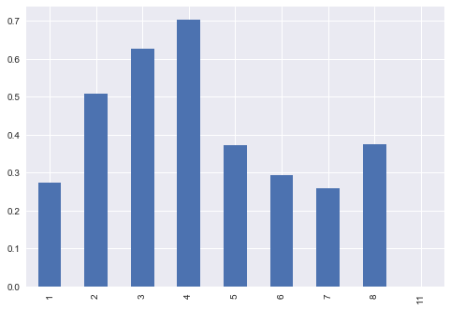
Did the group or family size affect survival rate?
Distribution of Group Sizes by Ticket ID Grouping
Potential optimal group size (4)
Can assist one another
Can fit into a lifeboat
Not likely that all members of a large group would survive
But difference between small groups (2-4) and large groups (>4) is notable
Survival Rates of Each Group Size

Slide 16
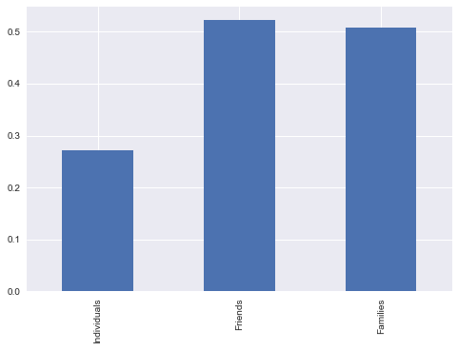
Did families have a higher survival rate than other group types?
Difficult to determine which groups were families and which groups were not
Being in a group does suggest a higher survival rate
Survival Rates of Different Group ‘Types’
Data ID | Name | Ticket
0 | Allen, Miss. Elisabeth Walton | 24160
180 | Kreuchen, Miss. Emilie | 24160
193 | Madill, Miss. Georgette Alexandra | 24160
238 | Robert, Mrs. Edward Scott (Elisabeth Walton Mc... | 24160

Slide 17
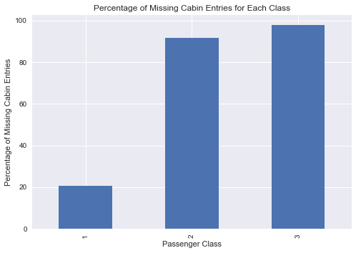
Was there less documentation for lower class passengers?
Missing cabin numbers

Slide 18
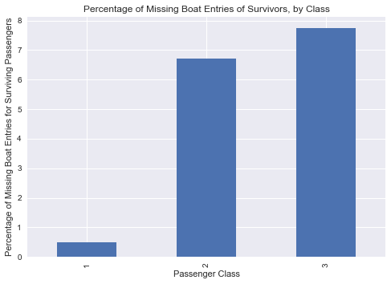
Was there less documentation for lower class passengers?
Missing boat numbers

Slide 19
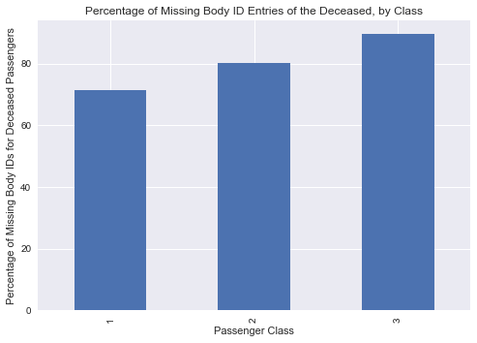
Was there less documentation for lower class passengers?
Missing body IDs

Slide 20
Was there less documentation for lower class passengers?
Many data integrity issues
Lower class passengers tended to have more missing information
Was information about wealthy people considered more important?
Is there a bias in data surrounding poorer people in the 1920s?
Percentage of missing data in each variable, by passenger class
class | age | fare | cabin | embarked | home.dest | boat (if survived) | body (if dead)
1 | 12.07% | 0.00% | 20.74% | 0.62% | 10.53% | 0.50% | 71.54%
2 | 5.78% | 0.00% | 91.70% | 0.00% | 5.78% | 6.72% | 80.38%
3 | 29.34% | 0.14% | 97.74% | 0.00% | 72.50% | 7.73% | 89.58%

Slide 21
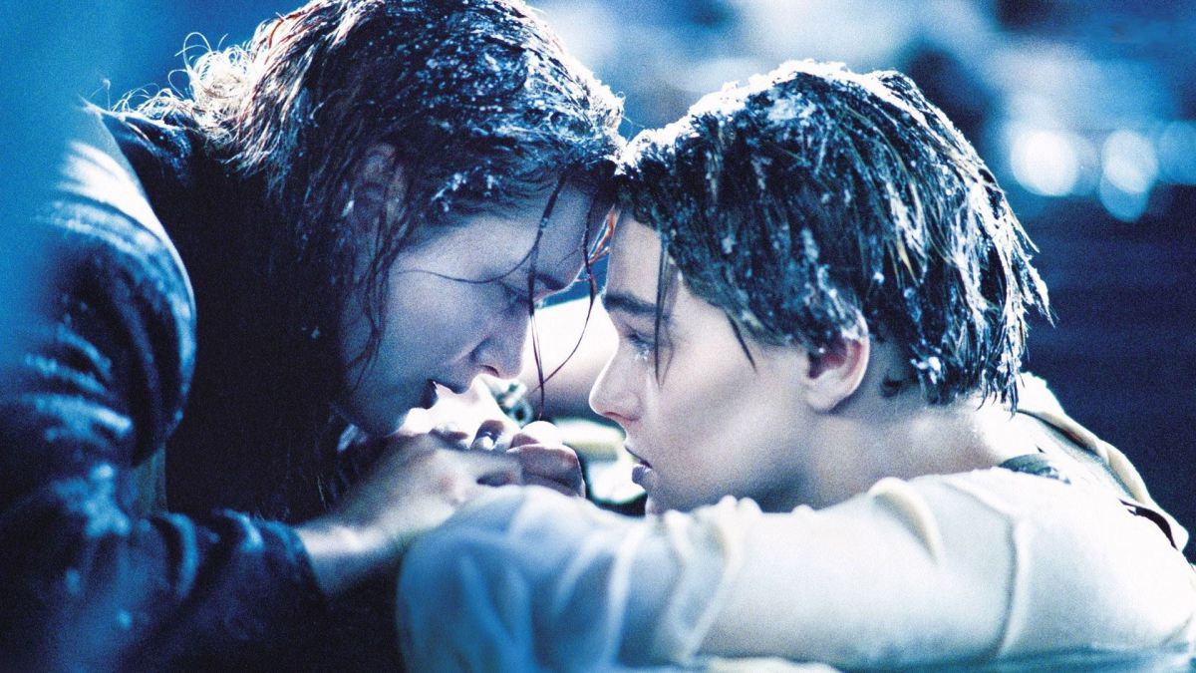
Summary
Don’t be a single, poor, adult, man from Southampton on the Titanic!!!
Also-- use tabs, not spaces.

Slide 22

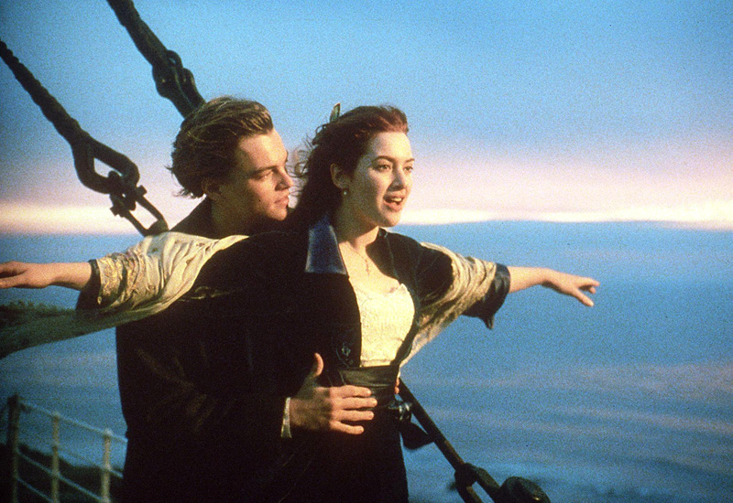
Thanks for a great semester
Python is king of the world!

